Slide 1
CS 470 Project Two Conference Presentation: Cloud Development
Matteo Russo
Feb. 2026

Slide 2
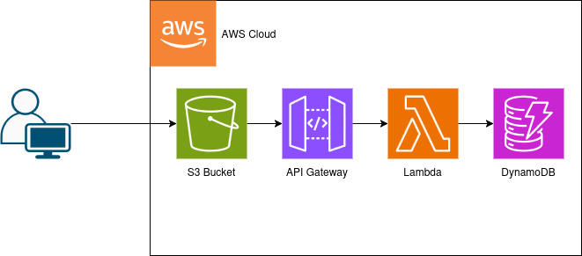
Overview
Who am I?
What is this about?
Notes:
I am a computer science student and the developer behind migrating the fullstack website to a cloud based site using AWS.
In this presentation I will go over the process of that migration, the tools used, and topics such as containerization, what is serverless, and how cloud based sites are structured.

Slide 3

Containerization
Turn your application into an array of boxes that can ship anywhere.
What tools are necessary for containerization?
Notes:
What is containerization?
This is the process of packaging your application and any dependencies, including OS libraries, that it needs to run into a self contained environment that can be run on any computer. If you are familiar with VMs, its like that without bringing the entire OS and other unneeded applications. Since the environment is captured this makes development and deployment much easier since the machine the application is moved to does not need to be changed before running the application.
Docker is a containerization tool for making and managing containers. By including a dockerfile into each part of the project, holding the commands needed to make a container, I was able to use Docker Desktop to take the original fullstack website and break it apart into containers, separating the frontend, backend, and database into three containers.

Slide 4
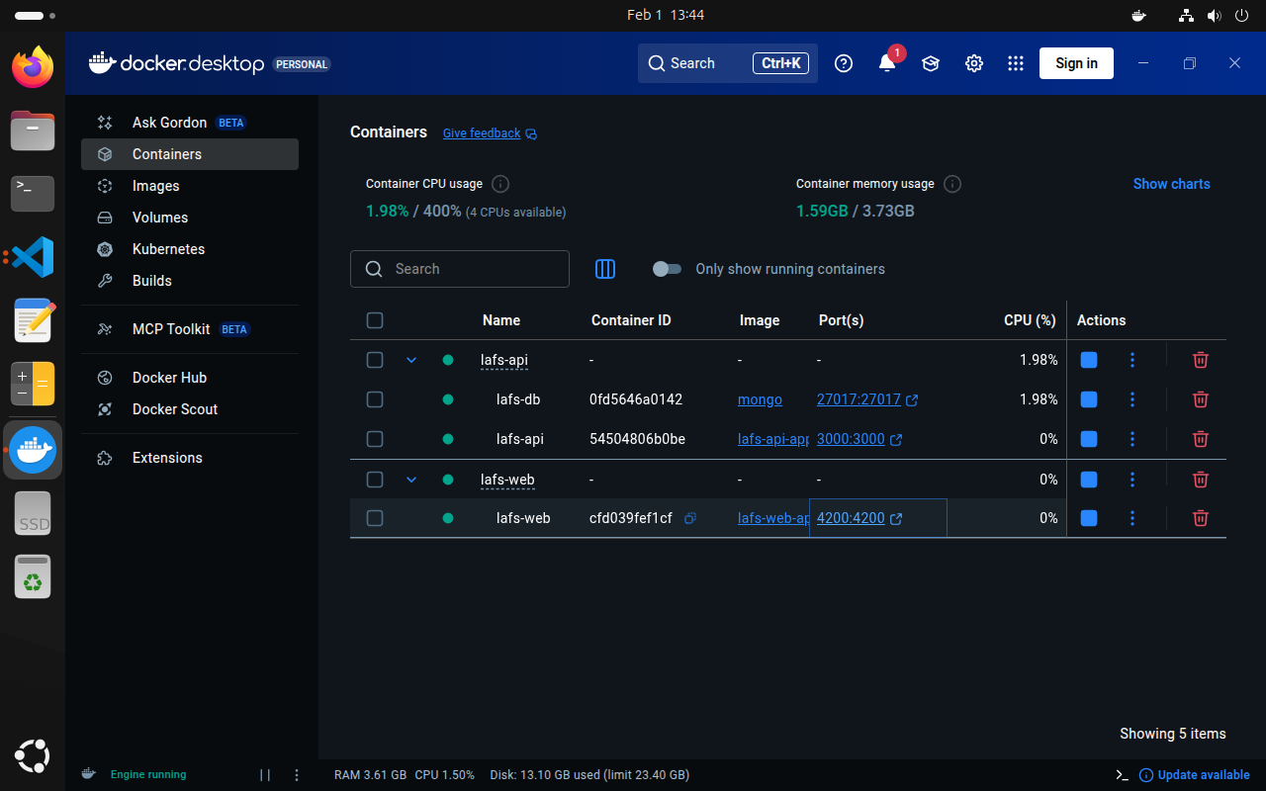
Orchestration
Multiple containers
Docker Compose
Your website
Notes:
Since containers are self contained environments they act as their own devices effectively, only communicating through the network with no knowledge of the other containers. To get these to work together and have the website work as a whole again I used Docker Compose and a bridge network.
Docker Compose and Docker Bridge Network allow multiple containers to know about each other and work together as containers rather than unknown devices. The bridge network is a private network for specified containers allowing only those containers to communicate.
With this, large applications can be broken down into components, much like the divide and conquer methodology in programming. This also promotes modularity of the application and increases security since the application has parts that are more isolated.
To get the backend to work with the database I added a docker compose file that describes to docker the services, networking, and storage details for the application.
With the website now broken apart into isolated containers it is now better suited for the AWS serverless environment since AWS is built on seperate services working together. For example it will be much easier to change the MongoDB database to the AWS DynamoDB without greatly changing the core code of the site.

Slide 5

The Serverless Cloud
Serverless
Where did the servers go?
Where does my website go?
What does it cost?
Notes:
Serverless is not truly serverless, only your company becomes serverless but your company is now borrowing someone else's servers. They maintain the hardware and infrastructure, you worry about your software.
With AWS this makes growth much easier to manage since scaling is automatic and you only pay for the compute you use. Put simply, just ask for more servers when you need them without having to worry about setup.
To host the website I had Angular build it for deployment then placed it into an AWS S3 cloud storage service. S3 is serverless storage with the capability to host static sites and built in security. With just this the site can be accessible but not get any data from servers.
S3 is the server in the clouds that expands as you need it. Compared to a local physical server this is much better for scaling and cost effectiveness since you no longer need to worry about physical maintenance of servers and set up costs.

Slide 6
The Serverless Cloud
API & Lambda
Advantages of using a serverless API.
Lambda API Logic.
What scripts are produced in order to make this happen?
Steps needed to integrate the frontend with the backend.
Notes:
Serverless API
Create functions with Lambda (single, short lived functions)
Map calls to functions using API Gateway
No need to manage server resources as api is used or grows
Lambda API
Event driven function calls, only runs when needed
Create small, stateless, short lived functions
Pay per use (no cost while unused)
AWS API Gateway
Maps calls to functions (REST API to Lambda), then manages returning results
Security (only entrypoint to API), allows security policy selection
Scripts
TableScan (get filtered and unfiltered results from any table), GetSingleRecord (get record from any table), UpsertQuestion (add/update record to Question table), UpsertAnswer (add/update record to Answer table), DeleteRecord (remove record from any table)
Test cases for each function
Functions for Create, Read, Update and Delete, aka GET, POST, PUT, DELETE
Frontend to Backend
In the angular site a simple change to the environment prod file will give our site the url to the created API. Rebuild with angular and redeploy to S3 will now allow the site to use the correct api url
CORS also needs to be enabled for each resource in the API
This is done in the API Gateway by defining an OPTIONS method to return the needed access control headers
Additionally CORS headers need to returned by the other GET, POST, PUT, and DELETE methods, which is done in Lambda when defining the response headers for the functions

Slide 7
The Serverless Cloud
Database
Prime Key | Attributes
101 | LastName Smith | FirstName Fred
102 | LastName Tom | FirstName Tim
What are the data-model differences between MongoDB and DynamoDB?
What queries did you perform?
What scripts are produced in order to make this happen?
{
“number”: 103,
“data”: {
“LastName”: “Richard”,
“FirstName”: “Chris”
},
}
Notes:
MongoDB
NoSQL, JSON based document
Flexible and rich querying
Designed for complex queries
Flexibility can lead to poor performance from query speeds as database grows
Overall very flexible and simple but allows for poor performance if not planned properly and requires more manual work to increase query optimization.
Requires more manual work to work with serverless.
DynamoDB
NoSQL, key/value pair
Designed for fast quarry speeds at large scale
Strict querying (key and secondary key) increases complexity in planning upfront but keeps query speeds fast
Built for serverless and AWS
Overall more rigid in design and complex upfront but for performance and serverless scaling
Queries/scripts
Using the api set up, clients now interact with this database through the api, which uses the lambda functions

Slide 8
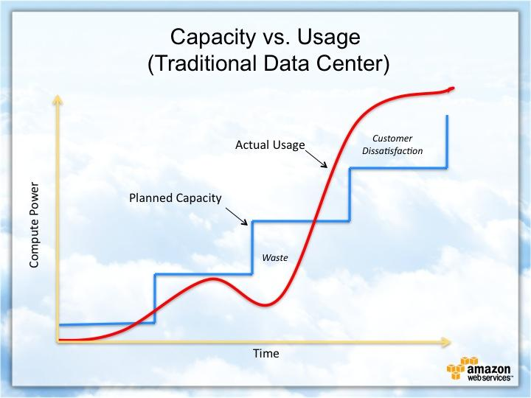
Cloud-Based Development Principles
Elasticity
Pay-for-use model
Notes:
Elasticity
ability to acquire and release resources as needed
resources no long fixed to physical servers
Pay for use
pay for resources you use
don’t need to pay to maintain, set up, and run hardware
hardware has limits, that when reached, require expansion that takes more time and investment
pay for what you actually use rather than unused hardware

Slide 9
Securing Your Cloud App
Access
Policies
API Security
How can you prevent unauthorized access?
Explain the relationship between roles and policies.
What custom policies were created?
How can you secure the connection between Lambda and Gateway?
Lambda and the database
S3 Bucket
Notes:
Access
Access control can be done just about every step of the way as each service allows for policies and roles to be used as well as keeping things private or making them publicly available.
Policies
Roles
Temporary security permissions for the session for an expected group of users
Controls who can access resources
Policies
JSON that explicitly states what actions are allowed on resources
Controls what actions can be done on resources
Can be attached to resources, roles, groups, or users
API Security
S3 buckets
Default private
Can be configured to run as a website using static website hosting
Set permissions to not block public access
Two layers of security, the bucket and the operations on the bucket
Once the bucket is public then you must enable read access operations with policies
This will now allow public access to the buckets endpoint
With our website packaged by Angular and deployed to an S3 bucket it is now serverless, it just lacks a database and public api now
Lambda to gateway
Gateway has a selection of security policies to choose from, I chose the recommended and latest Security Policy TLS, restricting the actions that users can perform with the api
Lambda to database
A role was selected for each lambda’s permission, restricting the use of the lambda to users with that role

Slide 10
CONCLUSION
Thank you for your time.
Notes:
As a quick recap
I prepared website for cloud environment with docker to split it up and containerize it.
I used Angular to build the frontend of the site for deployment
Uploaded the build to AWS S3 bucket
This creates a public endpoint users use to connect to the front end of the site
Created an API using Lambda and API Gateway
This creates a public endpoint for interaction with the database used by the frontend
Made a database with DynamoDB
Enabled CORS for resource sharing between each service
Secured the site with roles and policies
Website is now ready for public use

